Slide 1


Slide 2
GATE CSE- Digital Logic Syllabus
Number Representations
Computer Arithmetic (Fixed and Floating Point)
Boolean Algebra
Minimization
Combinational and Sequential Circuits
Weightage : 4 - 5 %

Slide 3
GATE 2025 Exam Pattern – Overview
Particulars | Description
Duration of Gate Exam | 180 minutes (3 hours)
Divisions in Gate Paper | Paper 1: General Aptitude (GA) Paper 2: Student Selected Subject
Total Number of Questions | Total: 65 General Aptitude: 10 Questions Selected Subjects: 55 Questions
Types of Questions in the GATE Exam | MCQ (Multiple Choice Questions) MSQ (Multiple Select Questions) NAT (Numerical Answer Type)
Distribution of marks for CS | Total Marks: 100 Mark GA – General Aptitude = 15 marks Engineering Math = 13 marks Subject Questions = 72 marks
Marking System | Questions Carry 1 mark or 2 marks.
Negative Marking in the GATE 2025 | For 1-mark MCQs, 1/3 marks will be deducted for an incorrect answer. For 2-mark MCQs, 2/3 marks will be deducted for an incorrect answer. There is no negative marking for wrong answers to MSQ or NAT Questions.

Slide 4
Overview
Digital Systems and Computer Systems
Information Representation
Number Systems [binary, octal, decimal and hexadecimal or Random base]
Arithmetic Operations
Base Conversion
Decimal Codes [BCD (binary coded decimal), parity]
Gray Codes
Alphanumeric Codes

Slide 5
Digital System
Takes a set of discrete information inputs and discrete internal information (system state) and generates a set of discrete information outputs.
Discrete
Discrete
Inputs
Information
Discrete
Processing
Outputs
System
System State

Slide 6
Types of Digital Systems
No state present
  Combinational Logic System
  Output = Function(Input)
State present
  State updated at discrete times
  => Synchronous Sequential System
  State updated at any time
  =>Asynchronous Sequential System
  State = Function (State, Input)
  Output = Function (State) or Function (State, Input)

Slide 7
Digital System Example:
A Digital Counter (e. g., odometer):
Count Up
0
0
1
3
5
6
4
Reset
Inputs:
Count Up, Reset
Outputs:
Visual Display
State:
"Value" of stored digits
Synchronous or Asynchronous?

Slide 8
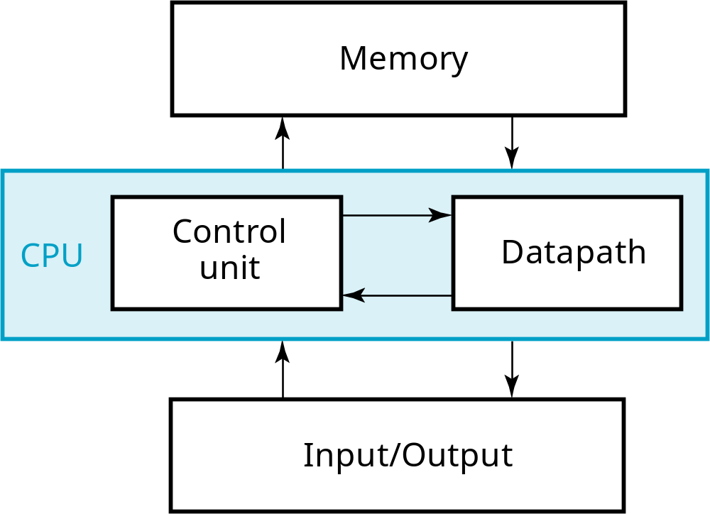
A Digital Computer Example
Inputs: Keyboard, mouse, modem, microphone
Outputs: CRT, LCD, modem, speakers
Synchronous or Asynchronous?
Notes:
Answer: Part of specification for a PC is in MHz. What does that imply? A clock which defines the discrete times for update of state for a synchronous system. Not all of the computer may be synchronous, however.

Slide 9
Signal
An information variable represented by physical quantity.
For digital systems, the variable takes on discrete values.
Two level, or binary values are the most prevalent values in digital systems.
Binary values are represented abstractly by:
  digits 0 and 1
  words (symbols) False (F) and True (T)
  words (symbols) Low (L) and High (H)
  and words On and Off.
Binary values are represented by values or ranges of values of physical quantities.

Slide 10
Binary Values: Other Physical Quantities
What are other physical quantities represent 0 and 1?
  CPU Voltage
  Disk
  CD
  Dynamic RAM
Magnetic Field Direction
Surface Pits/Light
Electrical Charge

Slide 11
Number Systems – Representation
Positive radix, positional number systems
A number with radix r is represented by a string of digits:
A_{n - 1}A_{n - 2} … A₁A₀ . A₋ ₁ A₋ ₂ … A_{- m + 1} A_{- m}
in which 0 ≤ A_{i} < r and . is the radix point.
The string of digits represents the power series:
(
)
(
)
i = n - 1
j = - 1
(Number)_{r}
=
∑
i
+
∑
j
A
r
A
r
i
j
i = 0
j = - m
(Integer Portion)
(Fraction Portion)
+

Slide 12
Number Systems – Examples
 | General | Decimal | Binary
Radix (Base) | r | 10 | 2
Digits | 0 => r - 1 | 0 => 9 | 0 => 1
0 1 2 3 Powers of 4 Radix 5 -1 -2 -3 -4 -5 | r⁰ r¹ r² r³ r⁴ r⁵ r ⁻¹ r ⁻² r ⁻³ r ⁻⁴ r ⁻⁵ | 1 10 100 1000 10,000 100,000 0.1 0.01 0.001 0.0001 0.00001 | 1 2 4 8 16 32 0.5 0.25 0.125 0.0625 0.03125

Slide 13
Special Powers of 2
2¹⁰ (1024) is Kilo, denoted "K"
2²⁰ (1,048,576) is Mega, denoted "M"
2³⁰ (1,073, 741,824)is Giga, denoted "G"

Slide 14
Positive Powers of 2
Useful for Base Conversion
Exponent
Value
Exponent
Value
0
1
11
2,048
1
2
12
4,096
2
4
13
8,192
3
8
14
16,384
4
16
15
32,768
5
32
16
65,536
6
64
17
131,072
7
128
18
262,144
8
256
19
524,288
9
512
20
1,048,576
10
1024
21
2,097,152

Slide 15
Number Base Conversion

Slide 16
Converting Binary to Decimal
To convert to decimal, use decimal arithmetic to form Σ (digit × respective power of 2).
Example: Convert 11010₂ to N₁₀:
Notes:
Powers of 2: 43210
11010₂ =>
1 X 2⁴ = 16
+ 1 X 2³ = 8
+ 0 X 2² = 0
+ 1 X 2¹ = 2
+ 0 X 2⁰ = 0
26₁₀

Slide 17
Converting Decimal to Binary
Method 1
  Subtract the largest power of 2 (see slide 14) that gives a positive remainder and record the power.
  Repeat, subtracting from the prior remainder and recording the power, until the remainder is zero.
  Place 1’s in the positions in the binary result corresponding to the powers recorded; in all other positions place 0’s.
Example: Convert 625₁₀ to N₂
Notes:
625 – 512 = 113 => 9
113 – 64 = 49 => 6
49 – 32 = 17 => 5
17 – 16 = 1 => 4
1 – 1 = 0 => 0
Placing 1’s in the result for the positions recorded and 0’s elsewhere,
9 8 7 6 5 4 3 2 1 0
1 0 0 1 1 1 0 0 0 1

Slide 18
Commonly Occurring Bases
Name
Radix
Digits
Binary
2
0,1
Octal
8
0,1,2,3,4,5,6,7
Decimal
10
0,1,2,3,4,5,6,7,8,9
Hexadecimal
16
0,1,2,3,4,5,6,7,8,9,A,B,C,D,E,F
The six letters (in addition to the 10 integers) in hexadecimal representation.
Notes:
Answer: The six letters A, B, C, D, E, and F represent the digits for values
10, 11, 12, 13, 14, 15 (given in decimal), respectively, in hexadecimal.
Alternatively, a, b, c, d, e, f are used.

Slide 19
Numbers in Different Bases
Good idea to memorize!
Decimal
Binary
Octal
Hexa
decimal
(Base 10)
(Base 2)
(Base 8)
(Base 16)
00
00000
00
00
01
00001
01
01
02
00010
02
02
03
00011
03
03
04
00100
04
04
05
00101
05
05
06
00110
06
06
07
00111
07
07
08
01000
10
08
09
01001
11
09
10
01010
12
0A
11
0101
1
13
0B
12
01100
14
0C
13
01101
15
0D
14
01110
16
0E
15
01111
17
0F
16
10000
20
10

Slide 20
Conversion Between Bases
Method 2
To convert from one base to another:
1) Convert the Integer Part
2) Convert the Fraction Part
3) Join the two results with a radix point

Slide 21
Conversion Details
To Convert the Integral Part:
  Repeatedly divide the number by the new radix and save the remainders. The digits for the new radix are the remainders in reverse order of their computation. If the new radix is > 10, then convert all remainders > 10 to digits A, B, …
To Convert the Fractional Part:
  Repeatedly multiply the fraction by the new radix and save the integer digits that result. The digits for the new radix are the integer digits in order of their computation. If the new radix is > 10, then convert all integers > 10 to digits A, B, …

Slide 22
Example: Convert 46.6875₁₀ To Base 2
Convert 46 to Base 2
Convert 0.6875 to Base 2:
Join the results together with the radix point:
Notes:
Answer 1: Converting 46 as integral part: Answer 2: Converting 0.6875 as fractional part:
46/2 = 23 rem = 0 0.6875 * 2 = 1.3750 int = 1
23/2 = 11 rem = 1 0.3750 * 2 = 0.7500 int = 0
11/2 = 5 remainder = 1 0.7500 * 2 = 1.5000 int = 1
5/2 = 2 remainder = 1 0.5000 * 2 = 1.0000 int = 1
2/2 = 1 remainder = 0 0.0000
1/2 = 0 remainder = 1 Reading off in the forward direction: 0.1011₂
Reading off in the reverse direction: 101110₂
Answer 3: Combining Integral and Fractional Parts:
101110. 1011₂

Slide 23
Additional Issue - Fractional Part
Note that in this conversion, the fractional part became 0 as a result of the repeated multiplications.
In general, it may take many bits to get this to happen or it may never happen.
Example: Convert 0.65₁₀ to N₂
  0.65 = 0.1010011001001 …
  The fractional part begins repeating every 4 steps yielding repeating 1001 forever!
Solution: Specify number of bits to right of radix point and round or truncate to this number.

Slide 24
Checking the Conversion: Crosscheck
To convert back, sum the digits times their respective powers of r.
From the prior conversion of 46.6875₁₀
101110₂ = 1·32 + 0·16 +1·8 +1·4 + 1·2 +0·1
= 32 + 8 + 4 + 2
= 46
0.1011₂ = 1/2 + 1/8 + 1/16
= 0.5000 + 0.1250 + 0.0625
= 0.6875

Slide 25
Octal /Hexadecimal to Binary and Back
Octal /Hexadecimal to Binary:
  Restate the octal /hexadecimal as three /four binary digits starting at the radix point and going both ways.
Binary to Octal / Hexadecimal:
  Group the binary digits into three /four bit groups starting at the radix point and going both ways, padding with zeros as needed in the fractional part.
  Convert each group of three bits to an octal (and four into hexadecimal) digit.

Slide 26
Octal to Hexadecimal via Binary
Convert octal to binary.
Use groups of four bits and convert as above to hexadecimal digits.
Example: Octal to Binary to Hexadecimal
6 3 5 . 1 7 7 ₈
Why do these conversions work?
Notes:
Answer: Marking off in groups of three (four) bits corresponds to dividing or multiplying by 2³ = 8 (2⁴ = 16) in the binary system.

Slide 27
A Final Conversion Note
You can use arithmetic in other bases if you are careful:
Example: Convert 101110₂ to Base 10 using binary arithmetic:
  Step 1 101110 / 1010 = 100 r 0110
  Step 2 100 / 1010 = 0 r 0100
  Converted Digits are 0100₂ | 0110₂
  or 4 6 ₁₀

Slide 28
GATE-2024 Set-2
Which of the following is/are EQUAL to 224 in radix 5 (i.e., base 5) notation?
    64 in radix 10
    100 in radix 8
    50 in radix 16
    121 in radix 7

Slide 29
GATE-2023
A particular number is written as 132 in radix-4 representation. The same number in radix-5 representation is ____________.
Notes:
110 base 5

Slide 30
GATE-2015
Consider the equation (43)x=(y3)8 where x and y are unknown. The number of possible solutions is _____
Notes:
(43)x=(y3)8
On solving, x=2y and x>=5 , y<=7, and x,y are int
So, (6, 3), (8, 4), (10, 5), (12, 6), (14, 7) are only possibilities.
Thus 5 solutions are possible.

Slide 31
GATE-2014 set-2
Consider the equation (123)₅=(x8)_{y} where x and y are unknown. The number of possible solutions is _____
Notes:
1, 30; 2, 15; 3, 10 are three possiblity

Slide 32
GATE-2014 set 1

Slide 33
GATE-2009
(1217)₈ is equivalent to
(1217)₁₆
(028F)₁₆
(2297)₁₀
(0B17)₁₆

Slide 34
Binary Numbers and Binary Coding
Flexibility of representation
  Within constraints below, can assign any binary combination (called a code word) to any data as long as data is uniquely encoded.
Information Types
  Numeric
    Must represent range of data needed
    Very desirable to represent data such that simple, straightforward computation for common arithmetic operations permitted
    Tight relation to binary numbers
  Non-numeric
    Greater flexibility since arithmetic operations not applied.
    Not tied to binary numbers

Slide 35
Non-numeric Binary Codes
Given n binary digits (called bits), a binary code is a mapping from a set of represented elements to a subset of the 2^{n} binary numbers.
Example: A binary code
for the seven colors of the
rainbow
Code 100 is not used
Color
Binary Number
Red
000
Orange
001
Yellow
010
Green
011
Blue
101
Indigo
110
Violet
111

Slide 36
Number of Bits Required
Given M elements to be represented by a binary code, the minimum number of bits, n, needed, satisfies the following relationships:
    2^{n} > M > 2^{(n – 1)}
    n = log₂ M where x , called the ceiling function, is the integer greater than or equal to x.
Example: How many bits are required to represent decimal digits with a binary code?
Notes:
M = 10
Therefore n = 4 since:
2⁴ =16 is ≥ 10 > 2³ = 8
and the ceiling function for log₂ 10 is 4.

Slide 37
Number of Elements Represented
Given n digits in radix r, there are r^{n} distinct elements that can be represented.
But, you can represent m elements, m < r^{n}
Examples:
  You can represent 4 elements in radix r = 2 with n = 2 digits: (00, 01, 10, 11).
  You can represent 4 elements in radix r = 2 with n = 4 digits: (0001, 0010, 0100, 1000).
  This second code is called a "one hot" code.

Slide 38
Binary Codes for Decimal Digits
There are over 8,000 ways that you can chose 10 elements from the 16 binary numbers of 4 bits. A few are useful:
Decimal
8,4,2,1
Excess3
8,4,
-
2,
-
1
Gray
0
0000
0011
0000
0000
1
0001
0100
0111
0100
2
0010
0101
0110
0101
3
0011
0110
0101
0111
4
0100
0111
0100
0110
5
0101
1000
1011
0010
6
0110
1001
1010
0011
7
0111
1010
1001
0001
8
1000
1011
1000
1001
9
1001
1
100
1111
1000

Slide 39
Binary Coded Decimal (BCD)
The BCD code is the 8,4,2,1 code.
This code is the simplest, most intuitive binary code for decimal digits and uses the same powers of 2 as a binary number, but only encodes the first ten values from 0 to 9.
Example: 1001 (9) = 1000 (8) + 0001 (1)
How many “invalid” code words are there?
What are the “invalid” code words?
Notes:
Answer 1: 6
Answer 2: 1010, 1011, 1100, 1101, 1110, 1111

Slide 40
Excess 3 Code and 8, 4, –2, –1 Code
Decimal | Excess 3 | 8, 4, –2, –1
0 | 0011 | 0000
1 | 0100 | 0111
2 | 0101 | 0110
3 | 0110 | 0101
4 | 0111 | 0100
5 | 1000 | 1011
6 | 1001 | 1010
7 | 1010 | 1001
8 | 1011 | 1000
9 | 1100 | 1111
Excess-3 code is a non-weighted code used to represent decimal digits. In this code, each decimal digit is represented by adding 3 to its corresponding 4-bit binary representation.
What interesting property is common to these two codes?
Complement Code
Notes:
Answer: Both of these codes have the property that the codes for 0 and 9, 1 and 8, etc. can be obtained from each other by replacing the 0’s with the 1’s and vice-versa in the code words. Such a code is sometimes called a complement code.

Slide 41
Gray Code
Decimal
8,4,2,1
Gray
 |  | 0000
 |  | 0001
 |  | 0011
 |  | 0010
 |  | 0110
 |  | 0111
 |  | 0101
 |  | 0100
 |  | 1100
 |  | 1101
What special property does the Gray code have in relation to adjacent decimal digits?
Gray code, also known as reflected binary code or unit distance code, is a binary numeral system where two successive values differ in only one bit. It is commonly used in telecommunications, error correction codes, and rotary encoders.
0
0000
1
0001
2
0010
3
0011
4
0100
It is simply XOR between
the consecutive digits in binary
5
0101
6
0110
7
0111
8
1000
9
1001
Notes:
Answer: As we “counts” up or down in decimal, the code word for the Gray code changes in only one bit position as we go from decimal digit to digit including from 9 to 0.

Slide 42
Gray Code (Continued)
Does this special Gray code property have any value?
An Example: Optical Shaft Encoder
111
000
100
000
B
0
B
1
110
001
101
001
B
2
G
2
G
1
010
111
G
0
101
011
100
011
110
010
(a) Binary Code for Positions 0 through 7
(b) Gray Code for Positions 0 through 7
Notes:
Yes, as illustrated by the example that followed.

Slide 43
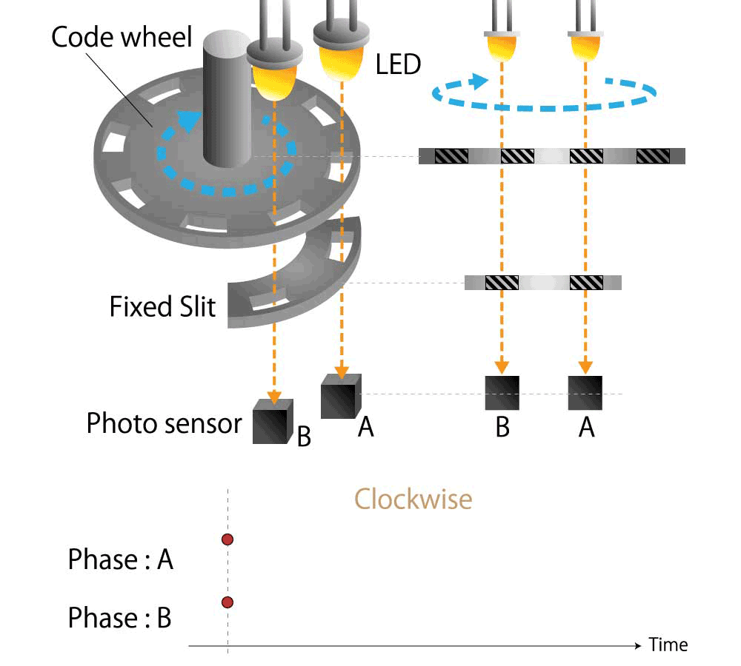
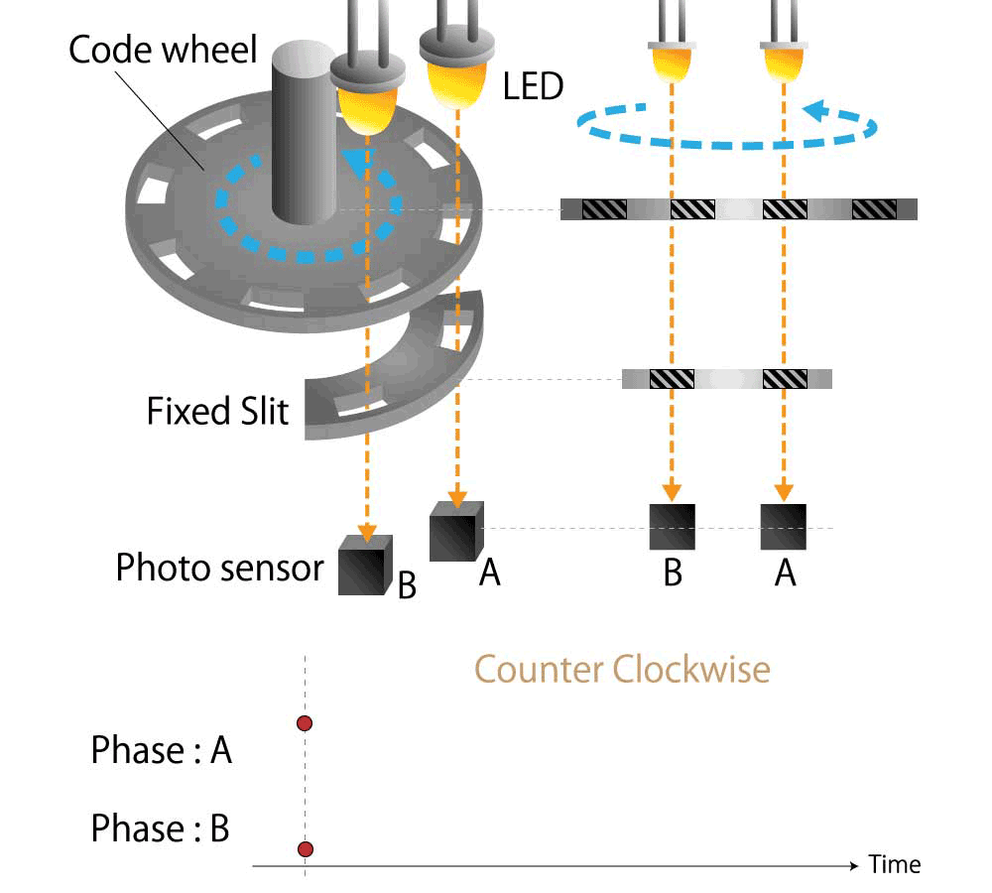
Optical Shaft Encoder- Used in point to point communication protocols

Slide 44
Warning: Conversion or Coding?
Do NOT mix up conversion of a decimal number to a binary number with coding a decimal number with a BINARY CODE.
13₁₀ = 1101₂ (This is conversion)
13 ⇔ 0001|0011 (This is coding)

Slide 45
Binary Arithmetic
Complements: 1’s and 2’s complement
Signed Binary Number
Single Bit Addition with Carry
Multiple Bit Addition
Single Bit Subtraction with Borrow
Multiple Bit Subtraction
Multiplication
BCD Addition

Slide 46
Complements
In digital electronics, complements are fundamental concepts used in arithmetic operations and digital circuit design.
Complements are alternative representations of numbers used for simplifying arithmetic operations and minimizing circuit complexity.
Types of Complements:
  Diminished Radix Complement: e.g. 1’s complement
  Radix Complement: Also known as the r's complement e.g. 2’s complement

Slide 47
Diminished Radix Complement
For a number 'N' with respect to radix 'r' having |N| digits, the (r-1)’s complement is defined as 'r^|N| - 1 - N'.
Diminished radix complement is commonly used in digital systems for addition operations.
1’s complement of 1010111
2^7-1-1010111 = 10000000-1-1010111
1111111-1010111 = 0101000
9’s complement of 54321₁₀
10^5-1-54321 = 100000 - 1 - 54321 = 99999-54321 = 45678₁₀

Slide 48
Radix Complement: r’s complement
Radix complement of a number 'N' with respect to radix 'r' is defined as 'r^|N| - N'.
Radix complement is used for subtraction operations.
It is nothing but (r-1)’s complement + 1.
2’s complement of 1010111 = 10000000 – 1010111 = 0101001
10’s complement of 12345 = 100000-12345 = 87655

Slide 49
Example: Using 10’s complement, subtract 72532 - 3250

Slide 50
Signed Binary Number
In sign-magnitude representation, the most significant bit (MSB) represents the sign of the number, while the remaining bits represent the magnitude.
Positive numbers have a 0 in the MSB, and negative numbers have a 1.
Sign-magnitude representation simplifies arithmetic operations but requires additional logic to handle sign.

Slide 51
2’s Complement form: Signed binary
1’s complement form
2’s complement form
Binary number 01101 (13)
1’s complement 10010
+ 1
2’s complement 10011 (-13)
Notes:
Informing the digital system beforehand to deal with a number as signed or unsigned is inconvenient
Signed binary numbers are represented in their 2’s complement form.
A 2’s complement of a binary number is achieved by first taking the 1’s complement of a number followed by its 2’s complement.
The 1’s complement of a binary number is obtained by simply inverting each bit.
The 2’s complement of a binary number is obtained by adding a 1 to the 1’s complement of the original number.
In a 2’s complement form all negative binary numbers are represented in their 2’s complement form
All such negative numbers have their most significant bit set to 1 signifying a negative number.
All positive numbers are represented in their original form.
Their most significant bit is a 0 specifying a positive number.

Slide 52
Let X be the number of distinct 16-bit integers in complement representation. Let Y be the number of distinct 16-bit integers in sign magnitude representation. Then X-Y is ____________.
GATE- 2016 set-2
Notes:
For n bit number 2’s complement range is 2^n
For signed bit, it is 2^n-1
So X-Y=1

Slide 53

The 16-bit 2’s complement representation of an integer is 1111 1111 1111 0101; its decimal representation is ____________.
GATE- 2016 set-1
Notes:
11

Slide 54
In 16-bit 2’s complement representation, the decimal number -28 is:
GATE- 2019
1000 0000 1110 0100
0000 0000 1110 0100
1111 1111 1110 0100
1111 1111 0001 1100

Slide 55
Addition and Subtraction with 2’s Complement: Signed Binary
0101 +5 0101 +5
0010 +2 1110 -2
0111 +7 0011 +3
1011 -5 1011 -5
1110 -2 0010 +2
1001 -7 1101 -3
(± A) –(+B) = (± A) +(-B)
(± A) +(+B) = (± A) -(-B)
the carry generated from the MSB is discarded
Notes:
There are four cases of addition
Both numbers are positive
0101 +5
0010 +2
0111 +7
Both numbers are negative
1011 -5
1110 -2
1001 -7 the carry generated from the msb is discarded
One number is positive and its magnitude is larger than the negative number
0101 +5
1110 -2
0011 +3 the carry generated from the msb is discarded
One number is positive and its magnitude is smaller than the negative number
1011 -5
0010 +2
1101 -3
By using signed number based on 2’s complement the addition operation serves to add and subtract numbers.

Slide 56
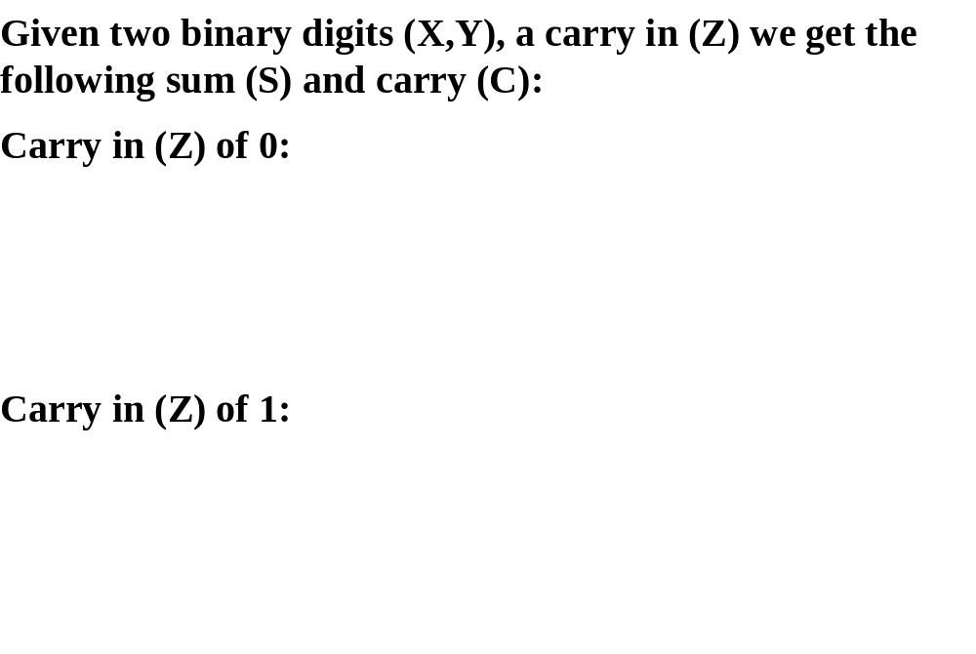
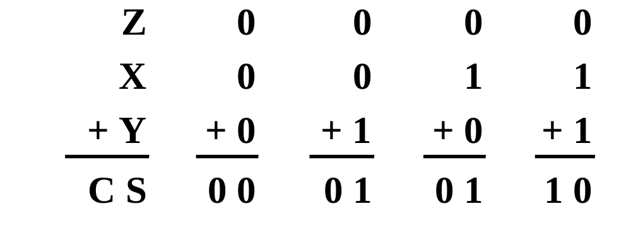
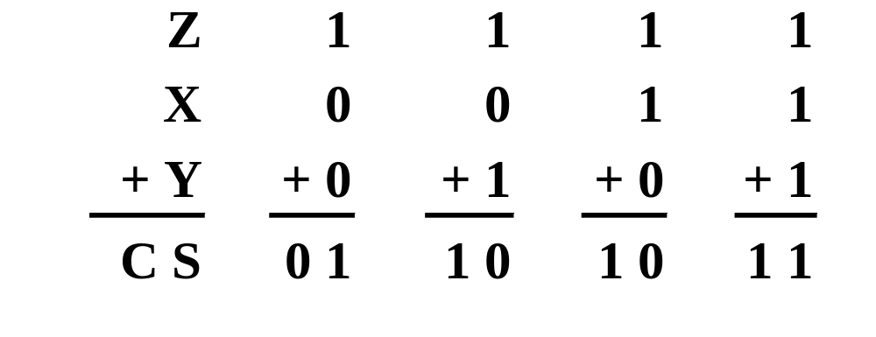
Single Bit Binary Addition with Carry
X | Y | Sum | Carry
0 | 0
0 | 1
1 | 0
1 | 1
X | Y | Z past carry | Sum | Carry
0 | 0 | 1
0 | 1 | 1
1 | 0 | 1
1 | 1 | 1

Slide 57
Multiple Bit Binary Addition
Extending this to two multiple bit examples:
Carries 0 0
Augend 01100 10110
Addend +10001 +10111
Sum
Note: The 0 is the default Carry-In to the least significant bit.
Notes:
Carries 00000 01100
Augend 01100 10110
Addend +10001 +10111
Sum 11101 101101

Slide 58
Single Bit Binary Subtraction with Borrow
Given two binary digits (X,Y), a borrow in (Z) we get the following difference (S) and borrow (B):
Borrow in (Z) of 0:
Borrow in (Z) of 1:
Z
0
0
0
0
X
0
0
1
1
- Y
-0
-1
-0
-1
B S
0 0
1 1
0 1
0 0
Z
1
1
1
1
X
0
0
1
1
- Y
-0
-1
-0
-1
BS
11
1 0
0 0
1 1

Slide 59
Multiple Bit Binary Subtraction
Extending this to two multiple bit examples:
Borrows 0 0
Minuend 10110 10110
Subtrahend - 10010 - 10011
Difference
Notes: The 0 is a Borrow-In to the least significant bit. If the Subtrahend > the Minuend, interchange and append a – to the result.
Notes:
Borrows 00000 00110
Minuend 10110 10110
Subtrahend –10010 –10011
Difference 00100 00011

Slide 60
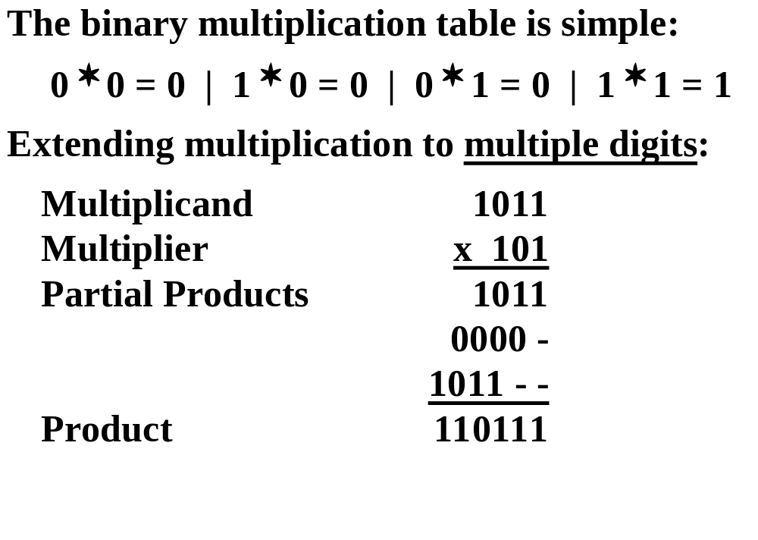
Binary Multiplication

Slide 61
BCD Arithmetic
Given a BCD code, we use binary arithmetic to add the digits:
8
1000
Eight
+5
+0101
Plus 5
13
1101
is 13 (> 9)
Note that the result is MORE THAN 9, so must be
represented by two digits!
To correct the digit, subtract 10 by adding 6 modulo 16.
8
1000
Eight
+5
+0101
Plus 5
13
1101
is 13 (> 9)
+0110
so add 6
carry = 1
0011
leaving 3 + cy
0001 | 0011
Final answer (two digits)
If the digit sum is > 9, add one to the next significant digit

Slide 62
BCD Addition Example
Add 2905_{BCD} to 1897_{BCD} showing carries and digit corrections.
0
0001 1000 1001 0111
+ 0010 1001 0000 0101
Notes:
1 1 1 0
0001 1000 1001 0111
+ 0010 1001 0000 0101
0100 10010 1010 1100
+ 0000+ 0110+ 0110+ 0110
0100 1000 0000 0010

Slide 63
Error-Detection Codes
Redundancy (e.g. extra information), in the form of extra bits, can be incorporated into binary code words to detect and correct errors.
A simple form of redundancy is parity, an extra bit appended onto the code word to make the number of 1’s odd or even. Parity can detect all single-bit errors and some multiple-bit errors.
A code word has even parity if the number of 1’s in the code word is even.
A code word has odd parity if the number of 1’s in the code word is odd.

Slide 64
4-Bit Parity Code Example
Fill in the even and odd parity bits:
The codeword "1111" has even parity and the codeword "1110" has odd parity. Both can be used to represent 3-bit data.
Even Parity
Odd Parity
Message
Parity
Message
Parity
-
-
000
-
000
-
001
-
001
-
010
-
010
-
011
-
011
-
100
-
100
-
101
-
101
-
110
-
110
-
111
-
111
-
Notes:
Even Parity Bits: 0, 1, 1, 0, 1, 0, 0, 1
Odd Parity Bits: 1, 0, 0, 1, 0, 1, 1, 0

Slide 65
ASCII Character Codes
American Standard Code for Information Interchange
This code is a popular code used to represent information sent as character-based data. It uses 7-bits to represent:
  94 Graphic printing characters.
  34 Non-printing characters
Some non-printing characters are used for text format (e.g. BS = Backspace, CR = carriage return)
Other non-printing characters are used for record marking and flow control (e.g. STX and ETX start and end text areas).

Slide 66
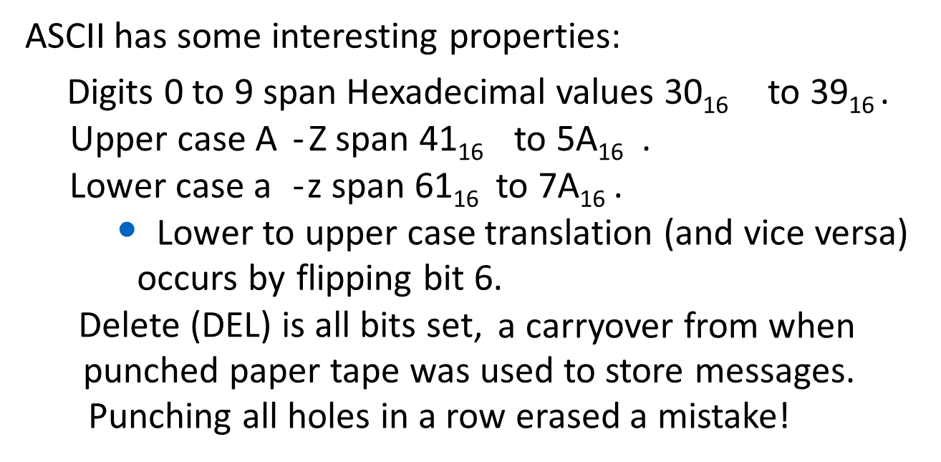
ASCII Properties

Slide 67
UNICODE
UNICODE extends ASCII to 65,536 universal characters codes
  For encoding characters in world languages
  Available in many modern applications
  2 byte (16-bit) code words

Slide 68
Let the representation of a number in base 3 be 210. What is the hexadecimal representation of the number?
GATE -2021 set-1
21
528
D2
15

